Slide 1
NextGen Tools Training
Basic R
January 2024

Slide 2
01
02
R
RStudio

Slide 3


Linga Baddam
Nicholas Eugenio
Sr. Principal Stat. Programmer
Stat. Programmer I

Slide 4
R
A language and environment for statistical computing and graphics

Slide 5
NextGen Tools
Where to find help?
OCEAN;
OAK;
{admiral}:
NEST;
GLoPO.

Slide 6
R
What is it?
In simple words, R is case sensitive language and environment for statistical computing and graphics;
It is the successor of S language and was created in 1992 by Ross Ihaka and Robert Gentleman at the University of Auckland. Nowadays, it is developed by the R Development Core Team;
R is designed to be used interactively and is similar to other programming languages like C, Java, and Python;
Almost everything in R is done by using functions and writing new ones is easy and very common;
The language is very popular in both academia and industry.

Slide 7
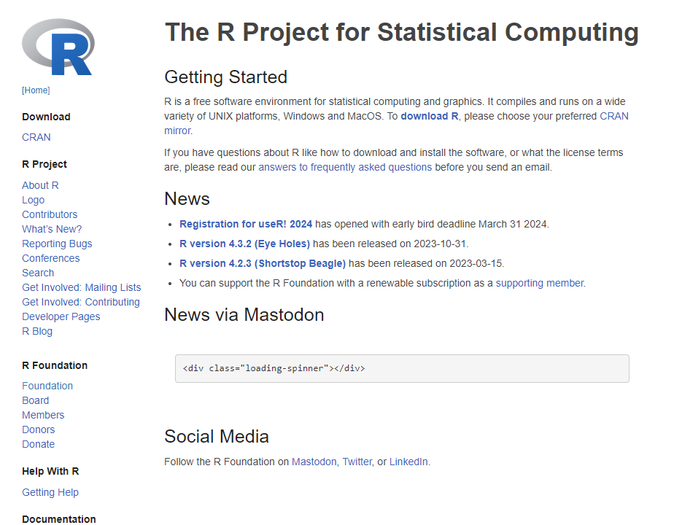
R
Official R website
https://www.r-project.org/, 01/17/2024

Slide 8
R
Usability and installation
R works on several Operational Systems (OS): Windows, Mac, and Linux;
R is most used as a Read-Eval-Print-Loop (REPL) environment:​
When it is started, it waits for user input;
Evaluates the input and prints the result;
Re-start the cycle;
There are some integrated development environments (IDEs) that make using R more visually and interactively enjoyable;
RStudio is an IDE for R and Python that includes a console, syntax-highlighting editor that supports direct code execution, and tools for plotting, history, debugging, and workspace management;
R can be installed from the Comprehensive R Archive Network (CRAN) and RStudio from posit.

Slide 9
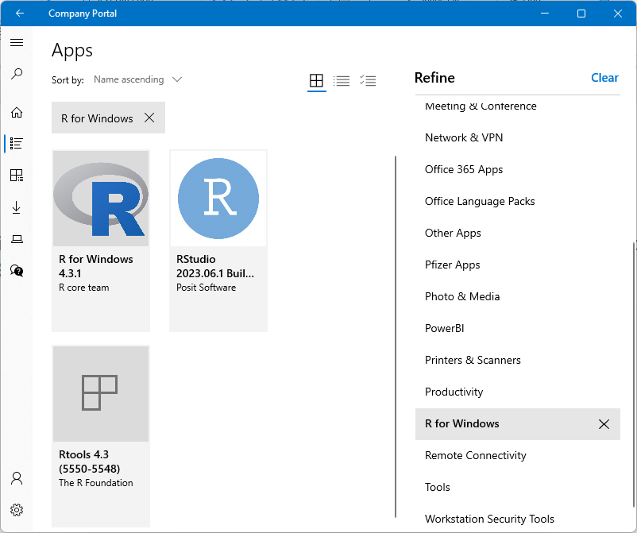
R & RStudio
Installation
On a Syneos machine, we can download R (1º) and RStudio (2º) from the Company Portal app. Finally, we can install Rtools (3º), toolchains for building R and R packages from source on Windows:
Company Portal app., 01/17/2024

Slide 10

RStudio
posit Cloud (formerly RStudio Cloud)
posit Cloud is the cloud instance for RStudio:
https://posit.cloud/, 01/17/2024

Slide 11
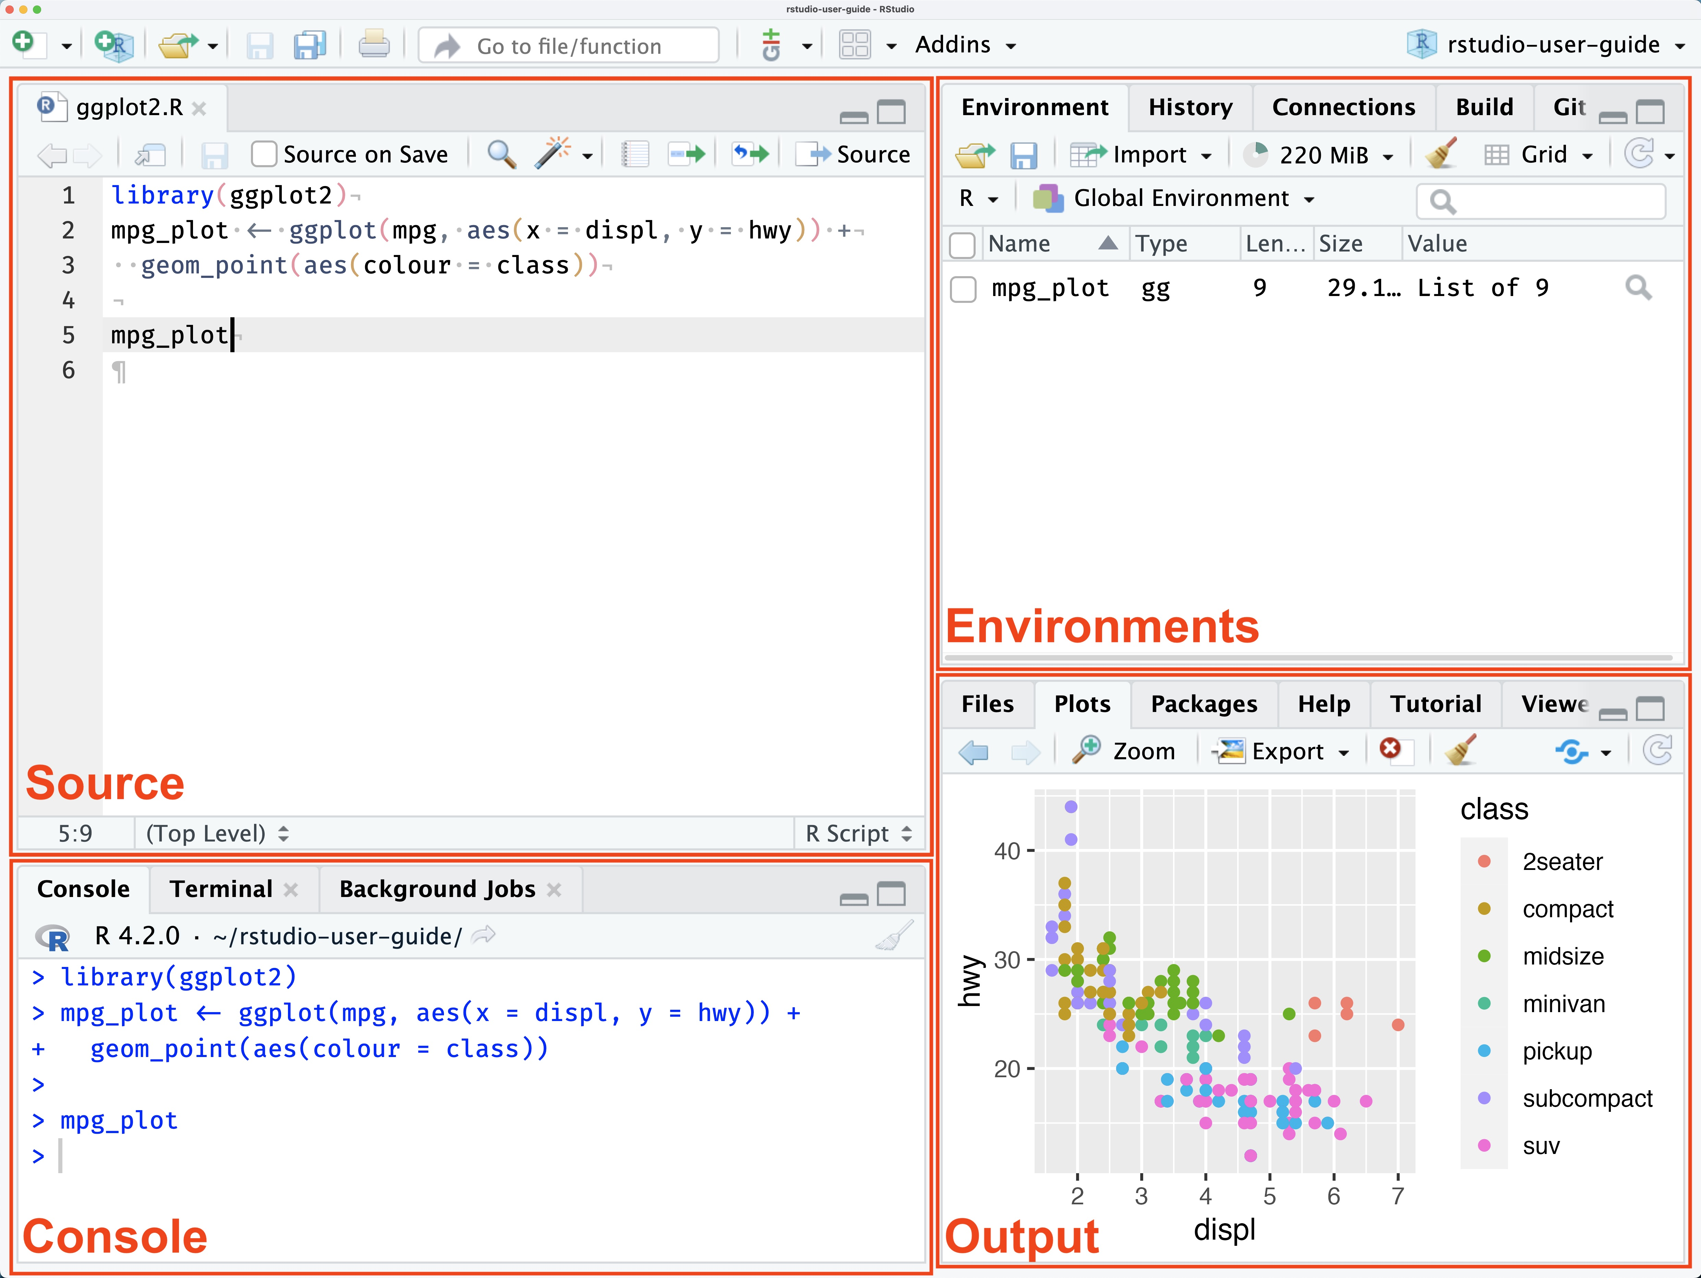
RStudio
Panes
Create a new R script (ctrl+shift+N);
Source: allows users to view and edit various code-related files, it is a text editor;
Console: provides an area to interactively execute code;
Environments: includes the Environment, History, Connections, Build, and Version Control System (VCS) tabs;
Output: displays various outputs such as plots, HTML content, or on-disk files.
https://docs.posit.co/ide/user/ide/guide/ui/ui-panes.html, 01/17/2024

Slide 12
RStudio
Projects and working directory
Projects are environments that keep all files associated with a given analysis (input data, R scripts, analytical results, and figures) together in one directory;
It provides access (loads) those files via a single object: the .Rproj file;
Each .Rproj is associated with a unique path, i.e., the virtual place where files lie;
The location on your computer that R uses for reading and writing files is called working directory (wd);
You can check your current working directory by running getwd() in the console or set it by running setwd(“<path>”);
.Rproj initializes in its “home” working directory path.

Slide 13
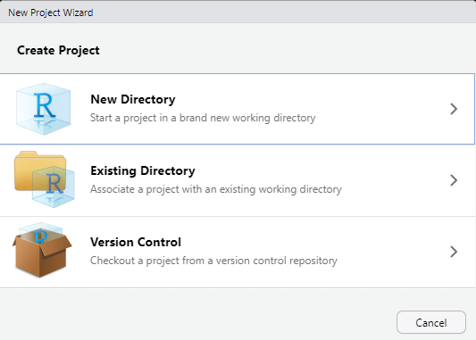
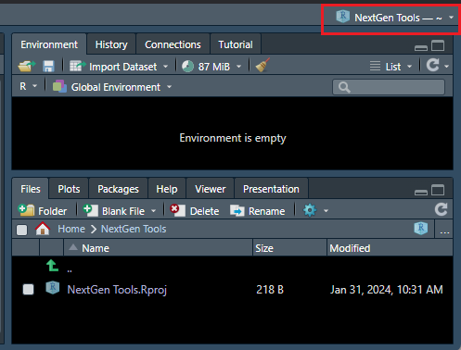
R
Project and .Rprofile
To create a project, click on “File → New Project…”;
Once the project is created, you can check its files and folders on “Files” tab in “Output” panel. Also, you can confirm the project is opened by looking in the highlighted area:
Project types
Dummy project

Slide 14
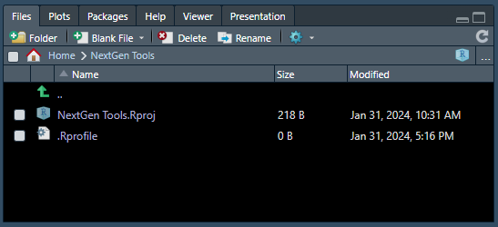
R
Project and .Rprofile
After creating the project, you may want to initialize it with a certain set of default settings;
This can be done by opening a new Text File, adding the desired commands, and saving it as “.Rprofile”:
.Rproject folder with .Rprofile

Slide 15
R
Packages and repositories
Packages are collections of R functions, data, and compiled code in a well-defined format, created to add specific functionality;
The “base” packages are the standard ones, considered part of the R source code and automatically available as part of your R installation. They contain the basic functions that allow R to work and enable standard statistical and graphical functions on datasets;
Other packages are located in the repositories, from where you can install them;
Repositories can be private or open:​
Comprehensive R Archive Network (CRAN): R's central software repository, supported by the R Foundation;
Github: although this is not R-specific, it is probably the most popular repository for open-source projects;
RStudio Package Manager (RSPM): Roche’s private repository (rspm.roche.com) with (un)validated packages.

Slide 16
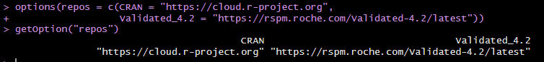
R
Packages and repositories
By default, R initializes with CRAN as the unique repository;
One can set multiple repository URLs and If the package you want to install is not found at the first link, R will try the second link, and so on.
This can be done by using the function “options(repos = <URL>)”:
Repositories

Slide 17
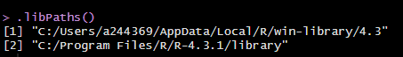
R
Packages and libraries
Libraries are the directories in R where the packages are stored;
You can check their paths by running “.libPaths()” on Console panel;
If the library path is not set at the moment of a package installation, R uses the first one;
It is possible to add paths to the list by running “.libPaths(c(<new_path>, .libPaths())”;
Libraries paths

Slide 18
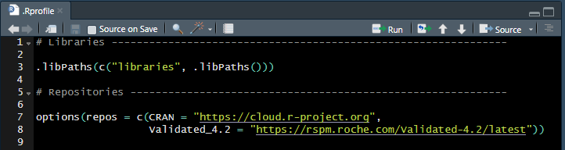
R
.Rproject, repositories, packages and libraries
While working on an R project, you may want to have your own library in your .Rproject environment. It is not uncommon to create a folder called “libraries” in your project directory;
Also, you may want to set “libraries” folder as the first in the list of libraries and to set your specific repositories for the project;
All this can be done and loaded when R initializes by populating the .Rprofile file:
.Rprofile

Slide 19
R
Installing packages
As the whole programming language, package names are case sensitive;
Use the “install.packages(“<package_name>”)” function to install packages;
To uninstall a package, use “remove.packages(“<package_name>”)”;
To check what packages need an update, use “old.packages()” and to update them use “update.packages()”;
Packages only need to be installed once.

Slide 20
R
Loading packages
Once the package is installed, you can load it into your R session for use;
To load a package use “library(<package_name>)”. Please notice that quotations are not required;
Any functions specific to that package will be available for you to use by simply calling the function as you would for any of the base functions.
You can also use a function for a specific package without loading it: “<package_name>::<function_name>”;

Slide 21
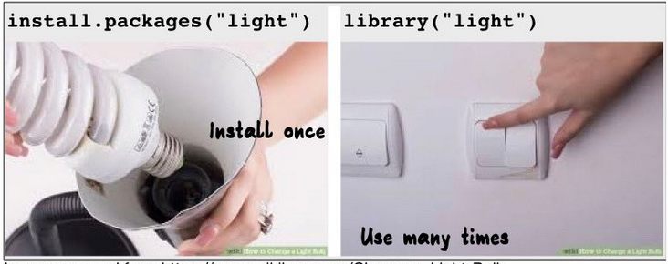
R
Installing and loading packages
“We only need to install a package once on our computer. However, to use the package, we need to load the library every time we start a new R/RStudio environment. You can think of this as installing a bulb versus turning on the light.”
https://hbctraining.github.io/Intro-to-R-flipped/lessons/04_introR_packages.html, 01/31/2024

Slide 22
R
Functions
Functions are “self contained” modules of code that accomplish a specific task and they usually take in some data structure (value, vector, dataframe etc.), process it, and return a result;
The input(s) are called arguments, which can include:
The physical object (any data structure) on which the function carries out a task;
Specifications that alter the way the function operates
The best way to understand a function is by calling the “help” function: “?<function_name”;
If you are familiar with the function and just need to remind yourself of the names of the arguments, you can use the “args” function: “args(<function_name>)”;
To run the examples section from the Online Help to see exactly how it works when executing the commands, you can use the “example” function: “example(“<function_name>”)”.

Slide 23
R
Algebra
R can essentially work as a calculator;
Arithmetic operators available in R:​
Addition: “+”;
Subtraction: “-”;
Division: “/”;
Multiplication: “*”;
Raise to a power: “^”;
Modulus: “%%”…
The order of operations is the same as the one you likely learned in high school, but they can be controlled by using parenthesis. Operations are performed from the innermost parenthesis;

Slide 24
R
Logical and relational operators
Logical operators are used to perform operations that involve boolean values (TRUE or FALSE):​
AND: “&”;
OR: “|”;
NOT: “!”…
Relational operators are used to compare between values:​
Greater than: “>”;
Less than: “<”;
Equal to: “==”;
Not equal to: “!=”;
Greater than or equal to: “>=”;
Less than or equal to: “<=”…

Slide 25
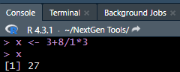
R
Objects
Most of the time, instead of just having the results of a calculation or a function appear in the console window, you may want to save them as objects/variables;
To save a result as an object/variable, simply think up a variable name, and then use the assign operator (“=” or “<-”) to assign the results to it;
To access the object, you simply need to run its name on Console:
Assigning and running object

Slide 26
R
Data structures
R’s base data structures are often organized by their dimensionality (1D, 2D, or nD) and whether they’re homogeneous (all elements must be of the identical type) or heterogeneous (the elements are often of various types);
This gives rise to the data types which are most frequently utilized in data analysis:​
Vectors;
Arrays;
Matrices;
Dataframes;
Lists.

Slide 27
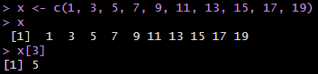
R
Vectors
Vector is a one-dimensional ordered collection of basic data types of a given length;
All the elements of a vector must be of the identical data type (homogeneous data structure);
A vector can be created using the “c(.)” function, which combines or concatenates its arguments;
Vector’s element can be accessed by its position, starting from 1, using square brackets “[.]”.
Vector example

Slide 28
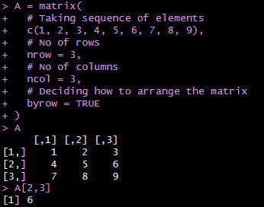
R
Matrices
Matrices are two-dimensional homogeneous data structures;
A matrix can be created with the use of the function “matrix(.)”;
The function’s arguments are the set of elements in the vector. You have to pass how many numbers of rows and how many numbers of columns you want to have in your matrix.
Matrix’s element can be accessed by its position “[row, column]”.
Matrix example

Slide 29
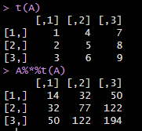
R
Matrices calculation
To perform matrix multiplication in the linear algebra sense (not just multiply each element by a constant), you should use the operator “%*%”;
To transpose a matrix, the function “t(.)” should be applied.
Matrix transpose and multiplication

Slide 30
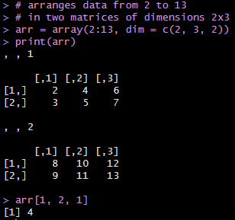
R
Arrays
Arrays are essential data storage structures defined by a fixed number of dimensions;
R Arrays consist of all elements of the same data type. Vectors are supplied as input to the function and then create an array based on the number of dimensions.
An R array can be created with the use of the function “array(row, column, matrix)”;
Array’s element can be accessed by its position “[row, column, matrix]”.
Array example

Slide 31
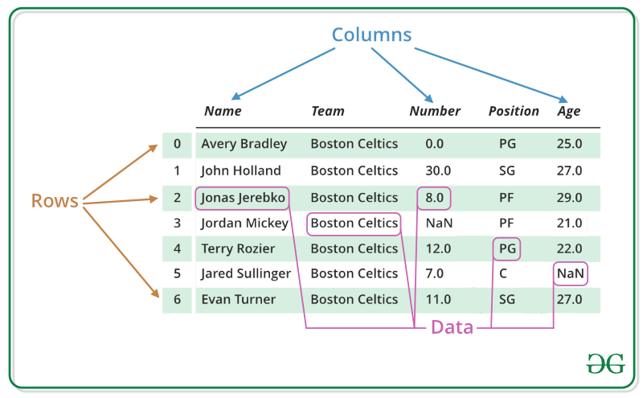
R
Dataframes
Dataframes are generic data objects of R that are used to store tabular data;
They can also be interpreted as matrices where each column of a matrix can be of different data types. It is made up of three principal components, the data, rows, and columns:
https://www.geeksforgeeks.org/r-data-frames/?ref=lbp, 02/02/2024

Slide 32
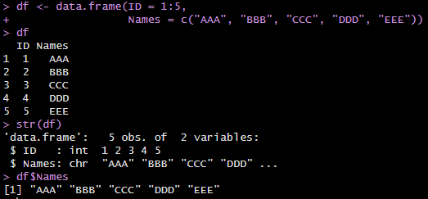
R
Dataframes
To create an R dataframe use the function “data.frame(.)” and then pass each of the vectors you have created as arguments to the function;
Use the function “str(.)” to check the structure of your dataframe and access a variable using the “$<name>” operator:
Dataframe example

Slide 33
R
Lists
A list in R is a generic object consisting of an ordered collection of objects. Lists are one-dimensional, heterogeneous data structures;
A list can be considered as a vector, but with heterogeneous data elements;
A list in R is created with the use of the “list(.)” function;
You can access the top-level elements of a list using the “$<name>” operator or the double slicing operator “[[.]]”;
To access the lower or inner-level components of an R list, you should use another square bracket “[.]” along with the double slicing operator: “[[.]][.]”.

Slide 34
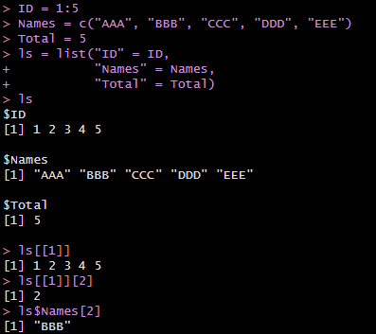
R
Lists
List example

Slide 35
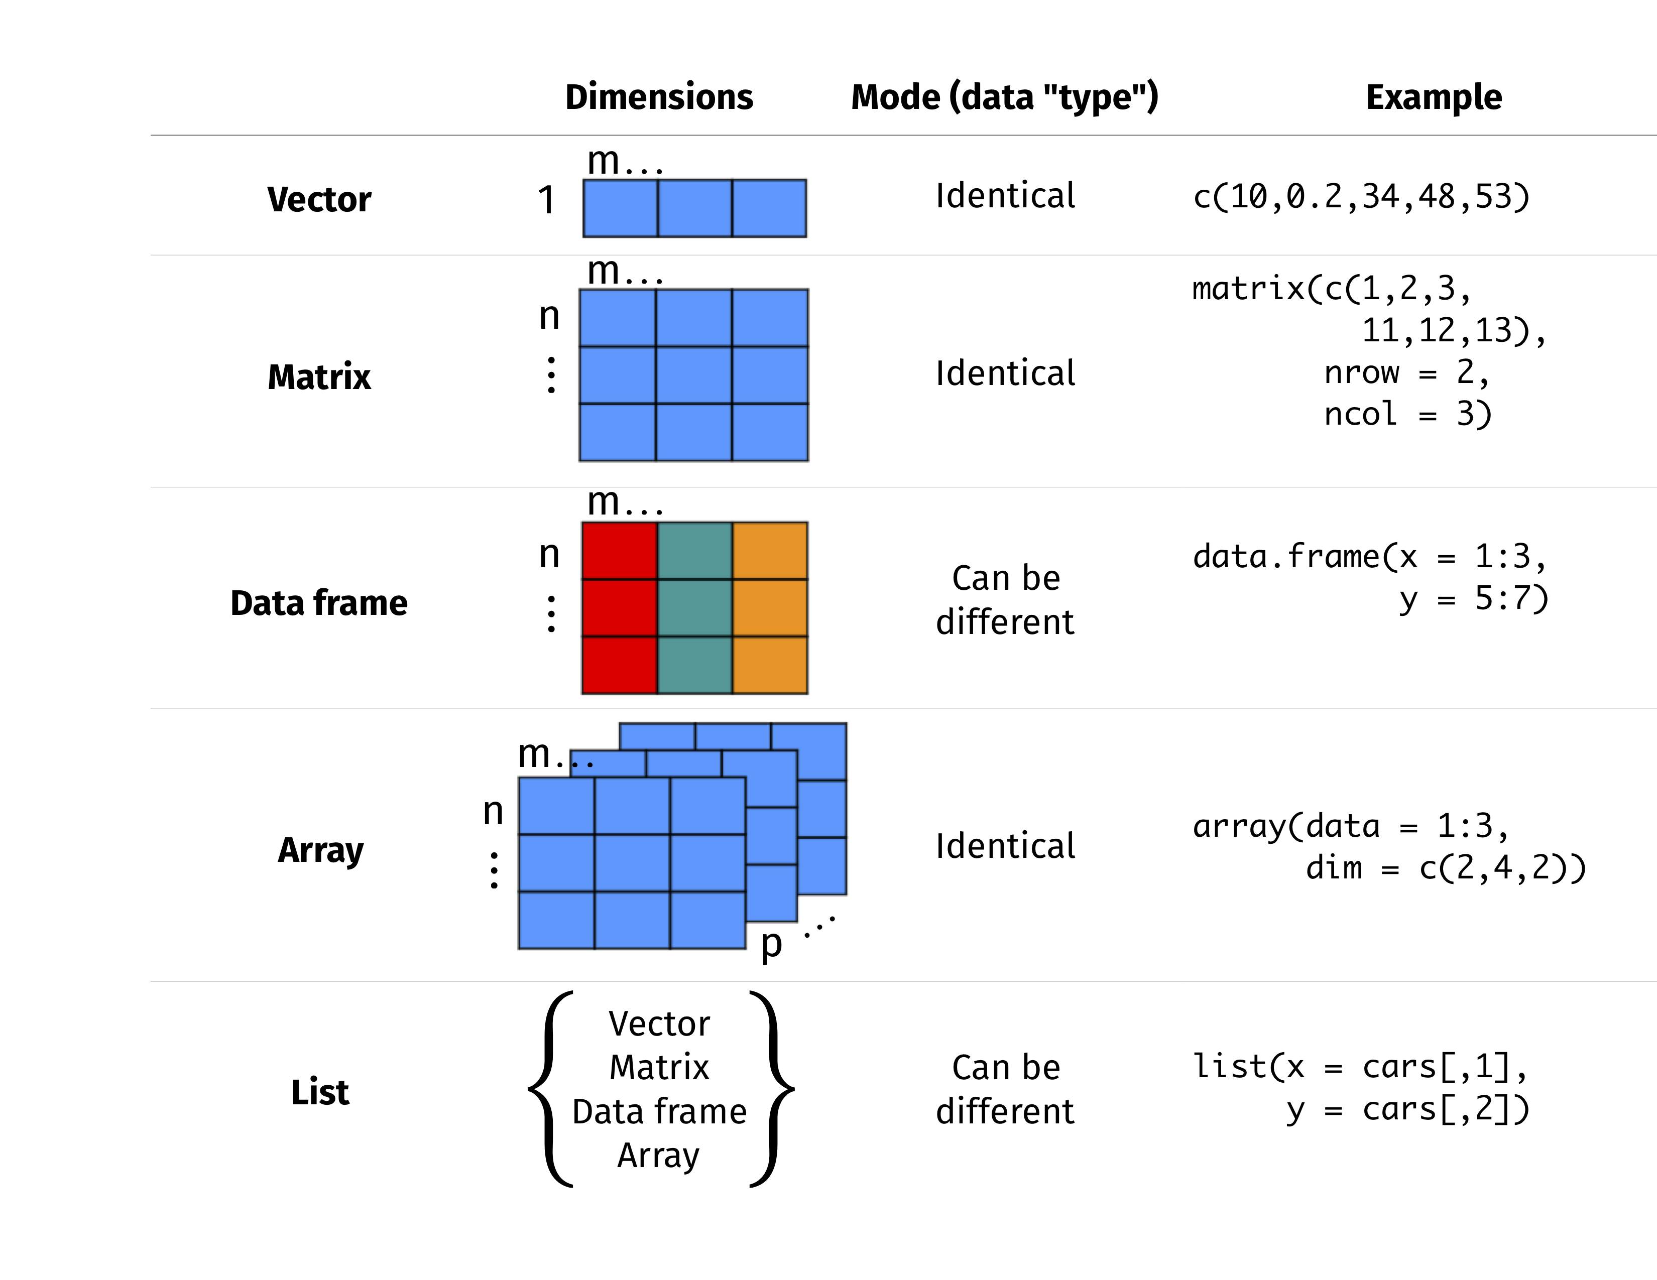
R
Data structures
https://images.app.goo.gl/DbKzfXqjs3AXPQjK6, 02/02/2024

Slide 36
R
Lists
A list in R is a generic object consisting of an ordered collection of objects. Lists are one-dimensional, heterogeneous data structures;
A list can be considered as a vector, but with heterogeneous data elements;
A list in R is created with the use of the “list(.)” function;
You can access the top-level elements of a list using the “$<name>” operator or the double slicing operator “[[.]]”;
To access the lower or inner-level components of an R list, you should use another square bracket “[.]” along with the double slicing operator: “[[.]][.]”.

Slide 37
R
Useful links
R 4 Data Science;
SWIRL;
Training By Packt.

Slide 38

R
Questions

